Slide 1
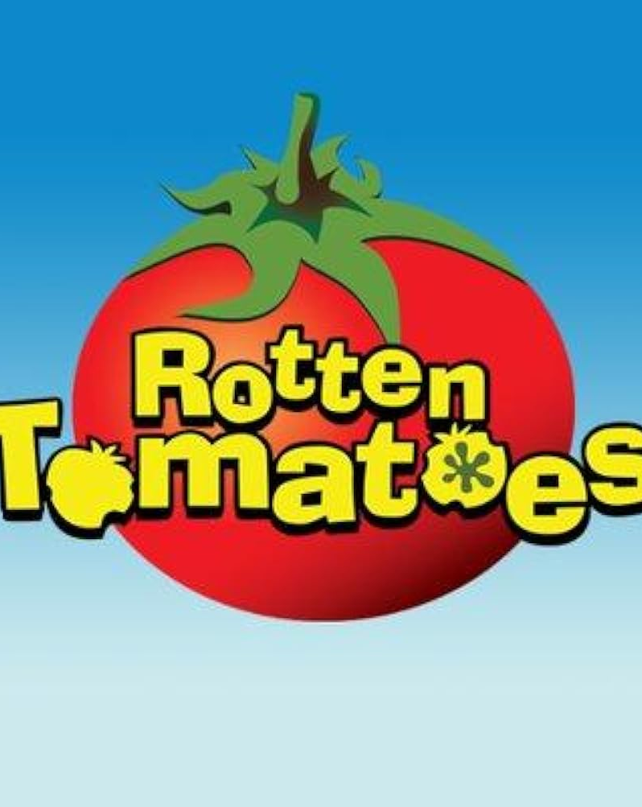
SENTIMENT SENTIMENT ​ SENTIMENT ANALYSIS ANALYSIS ANALYSIS
Notes:
"Welcome everyone. Today, we're diving into our sentiment analysis project on Rotten Tomatoes movie reviews. In an era where online opinions significantly influence consumer choices, understanding sentiment in movie reviews is crucial for the film industry. Our project aims to leverage data science to gain insights from these reviews."

Slide 2
Link
Notes:
"Welcome everyone. Today, we're diving into our sentiment analysis project on Rotten Tomatoes movie reviews. In an era where online opinions significantly influence consumer choices, understanding sentiment in movie reviews is crucial for the film industry. Our project aims to leverage data science to gain insights from these reviews."

Slide 3
agenda
a
Introduction
Methodology
Analysis
Results
Problem Statement Data description
Data Preprocessing Feature Engineering
Exploratory Data Analysis Model Selection Error Analysis
Model Performance Feature Importance Challenges and Limitations

Slide 4
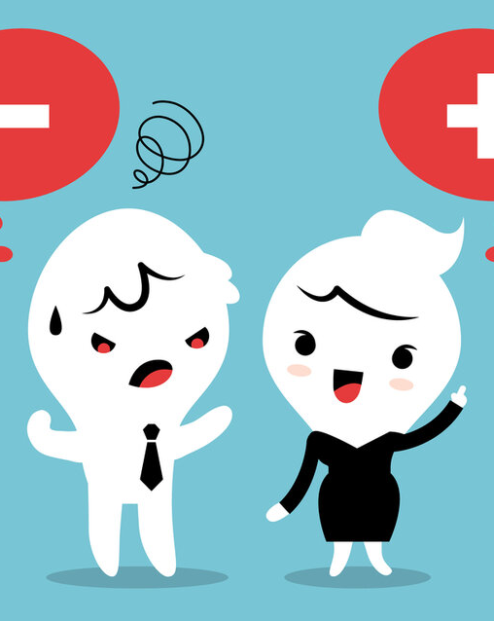
problem statement
The entertainment industry relies on understanding audience opinions for decisions. Platforms like rotten tomatoes have vast reviews, posing a challenge in getting insights.
Our main objective is to develop an automated sentiment analysis model. We set out to answer two key questions:
Can we accurately classify review sentiment?
What factors influence review sentiment?
These questions are vital for understanding audience reception and potentially predicting movie success."

Slide 5
DATA DESCRIPTION
We worked with two primary datasets:
A reviews dataset containing critic reviews, scores and dates.
A movies dataset with details like title, genre, and release date.
Our combined dataset included 1129886 reviews spanning 1800-01-01 to 2020-10-29. This rich dataset provided a comprehensive view of critic sentiment over time.
Total number of rows: 1129886
Total number of columns: 30

Slide 6
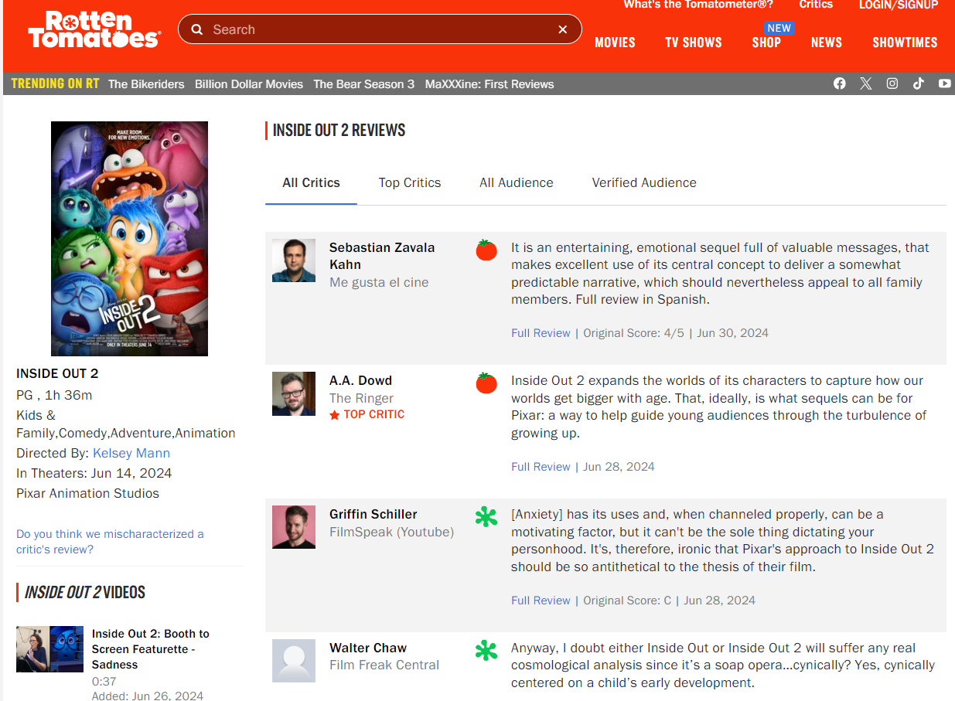
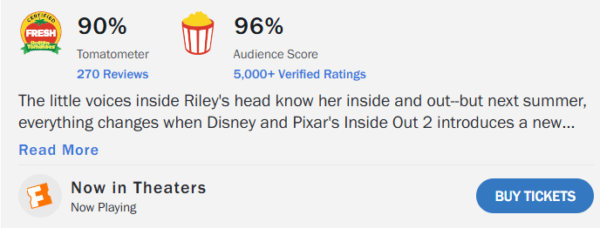
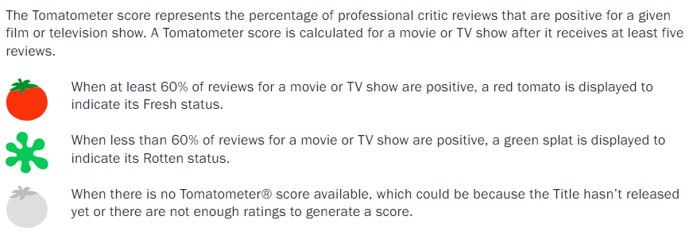
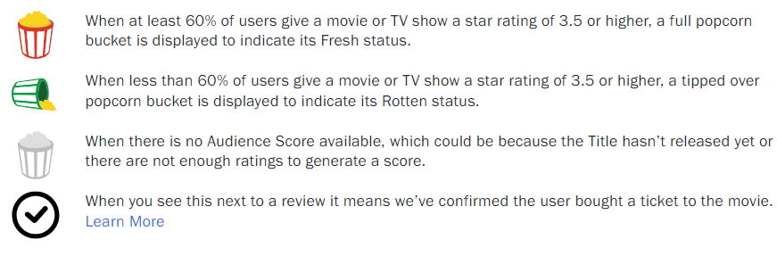
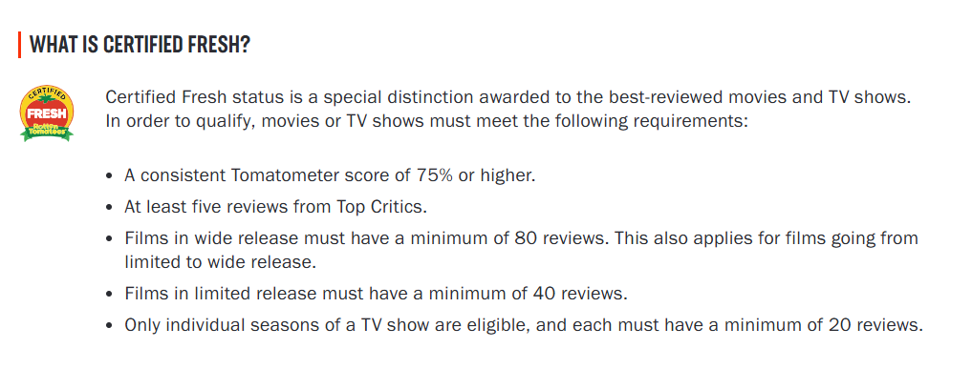

Slide 7
DATA DESCRIPTION
rotten_tomatoes_link: Link to the Rotten Tomatoes page for the specific movie.
critic_name: Name of the critic who wrote the review.
top_critic: Binary indicator of whether it is a top critic.
publisher_name: Name of the publisher.
review_type: Type of review (e.g., Fresh, Rotten) indicating sentiment.
review_score: Score given by the critic to the movie.
review_date: Date of the review.
review_content: Content of the movie review written by the critic.
movie_title: Title of the movie.
movie_info: Additional information about the movie.
critics_consensus: Overall opinion written by critics about a movie
content_rating: Rating given by the critic for a movie
genres: Genres of movie such as drama, comedy, action etc.
directors: Directors of the movie.
writers: Writers of the movie.
cast: Actors cast of the movie.
studio: Studio that produced the movie.
runtime: Runtime of the movie in minutes
production_company : Production company.
tomatometer_status: status of the review, such as "Fresh" or "Rotten," based on its score.
tomatometer_rating: Tomatometer rating.
tomatometer_count: Tomatometer count.
audience_status: Audience status.
audience_rating: Audience rating.
audience_count: Audience count.
tomatometer_top_critics_count: Count of top critics in the tomatometer.
tomatometer_fresh_critics_count: Count of fresh critics in the tomatometer.
tomatometer_rotten_critics_count: Count of rotten critics in the tomatometer.
cleaned_review_content: Cleaned review content.
review_length: Length of the review content in words.

Slide 8
DATA DESCRIPTION
Numeric Columns | Categorical Columns
tomatometer_rating | rotten_tomatoes_link | genres
tomatometer_count | critic_name | directors
audience_rating | top_critic | writers
audience_count | publisher_name | cast
tomatometer_top_critics_count | review_type | studio
tomatometer_fresh_critics_count | review_score | runtime
tomatometer_rotten_critics_count | review_date | production_company
review_length | review_content | tomatometer_status
 | movie_title | audience_status
 | movie_info | cleaned_review_content

Slide 9
Feature engineering
By incorporating feature engineering techniques, we transformed our data into a format that enhances the performance and interpretability of the sentiment analysis models. This includes creating, modifying, or selecting features that can enhance the model's predictive power and ability to generalize from the training data to unseen data.
The steps in feature engineering techniques used for sentiment analysis are:
1. Creating new variables:
Sentiment variable: Created a binary ‘sentiment’ variable from the review_type column. (fresh = 1, rotten = 0)
Processed review variable: Created a new variable ‘processed_review’ that contains the preprocessed review text
Review Length: Created a new variable ‘review_length’ to get the length of the processed review text.
2. Transformed features:
The processed_review variable was created by transforming the original ‘review_content’ through several data preprocessing steps.
The ‘processed_review’ variable was then used for vectorization and model training.

Slide 10
Feature engineering Data preprocessing
Removing stop words
Handling negations
Lowercasing, Removing punctuations and special characters
Tokenization
Lemmatization
Vectorization

Slide 11
Data preprocessing Steps
Text Cleaning: Removed unwanted characters, punctuation, and extra spaces, and converted all text to lowercase for consistency.
For example, the review 'The movie was AMAZING! I loved the special effects and the acting was top-notch.' was cleaned to 'the movie was amazing i loved the special effects and the acting was top notch'.
Stop Words Removal: Extended the list of stop words to include additional common terms such as 'film' and 'movie' that do not contribute much to the meaning of the text.
For instance, after removing stop words, the cleaned review becomes 'amazing loved special effects acting top notch'.
Tokenization: The cleaned text was split into individual words or tokens, which is essential for text vectorization.
The previous example would be tokenized into ['amazing', 'loved', 'special', 'effects', 'acting', 'top', 'notch'].
N-grams Generation: Generated n-grams to capture context and word sequences. This included both unigrams and bigrams.
For example, the bigrams for the review would include ['amazing loved', 'loved special', 'special effects', 'effects acting', 'acting top', 'top notch'].
Length Features: Calculated the length of each cleaned review in terms of word count. For example, the length of the review 'amazing loved special effects acting top notch' is 7 words.
Vectorization Techniques: Used Bag of Words (BoW) and TF-IDF (Term Frequency-Inverse Document Frequency) to convert the text into numerical feature vectors."
Notes:
Slide 10: Data Preprocessing
Script: "In our data preprocessing stage, we focused on cleaning the review text to make it suitable for analysis. This involved several steps:
Text Cleaning: We removed unwanted characters, punctuation, and extra spaces, and converted all text to lowercase for consistency. For example, the review 'The movie was AMAZING! I loved the special effects and the acting was top-notch.' was cleaned to 'the movie was amazing i loved the special effects and the acting was top notch'. (The sentence is transformed into lower case with no punctuations)
Stop Words Removal: We extended the list of stop words to include additional common terms such as 'film' and 'movie' that do not contribute much to the meaning of the text. For instance, after removing stop words, the cleaned review becomes 'amazing loved special effects acting top notch'.
Tokenization: The cleaned text was split into individual words or tokens, which is essential for text vectorization. The previous example would be tokenized into ['amazing', 'loved', 'special', 'effects', 'acting', 'top', 'notch'].
N-grams Generation: We generated n-grams to capture context and word sequences. This included both unigrams and bigrams. For example, the bigrams for the review would include ['amazing loved', 'loved special', 'special effects', 'effects acting', 'acting top', 'top notch'].
Length Features: We calculated the length of each review in terms of word count. For example, the length of the review 'amazing loved special effects acting top notch' is 7 words.
Vectorization Techniques: We used Bag of Words (BoW) and TF-IDF (Term Frequency-Inverse Document Frequency) to convert the text into numerical feature vectors."

Slide 12

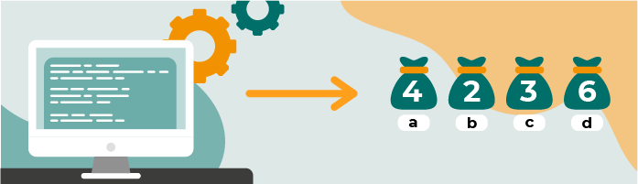
Data preprocessing: Vectorization
For feature engineering, we primarily used bag of words and TF-IDF vectorization.
Bag of Words (BoW): This method only considers the frequency of words within each document. The text was converted into a matrix of word counts using the Count Vectorizer.
For example, the review 'amazing loved special effects acting top notch' would be transformed into a vector with counts of each word.
TF-IDF (Term Frequency-Inverse Document Frequency): This technique helps capture the importance of words in the context of our entire dataset.
For example, words like 'amazing' and 'loved' may have higher TF-IDF scores compared to common words like 'movie'.
While BoW only considers the frequency of words within each document, TF-IDF technique helps capture the importance of words in the context of our entire dataset.
Notes:
Slide 11: Vectorization Techniques
Script: "For feature engineering, we primarily used Bag of Words and TF-IDF vectorization.
Bag of Words (BoW): This method only considers the frequency of words within each document. For example, the review 'amazing loved special effects acting top notch' would be transformed into a vector with counts of each word.
TF-IDF (Term Frequency-Inverse Document Frequency):
Term Frequency (TF): Measures the frequency of a word in a document.
Inverse Document Frequency (IDF): Measures how important a word is in the entire corpus.
TF-IDF Calculation: The TF-IDF score for each word in a document is calculated by multiplying its TF and IDF scores.
This technique helps capture the importance of words in the context of our entire dataset. For example, words like 'amazing' and 'loved' may have higher TF-IDF scores compared to common words like 'movie'.

Slide 13
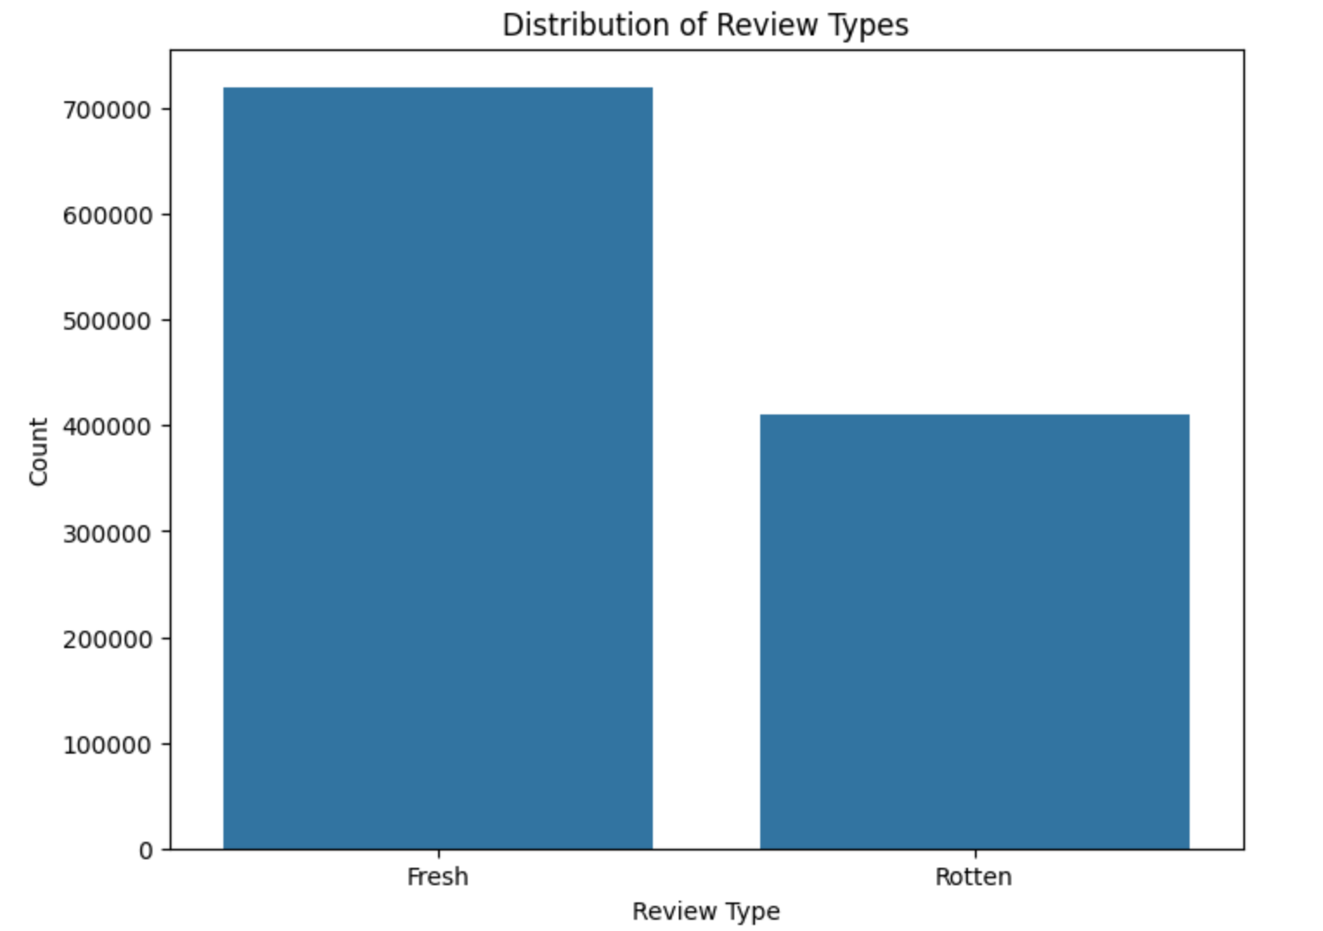
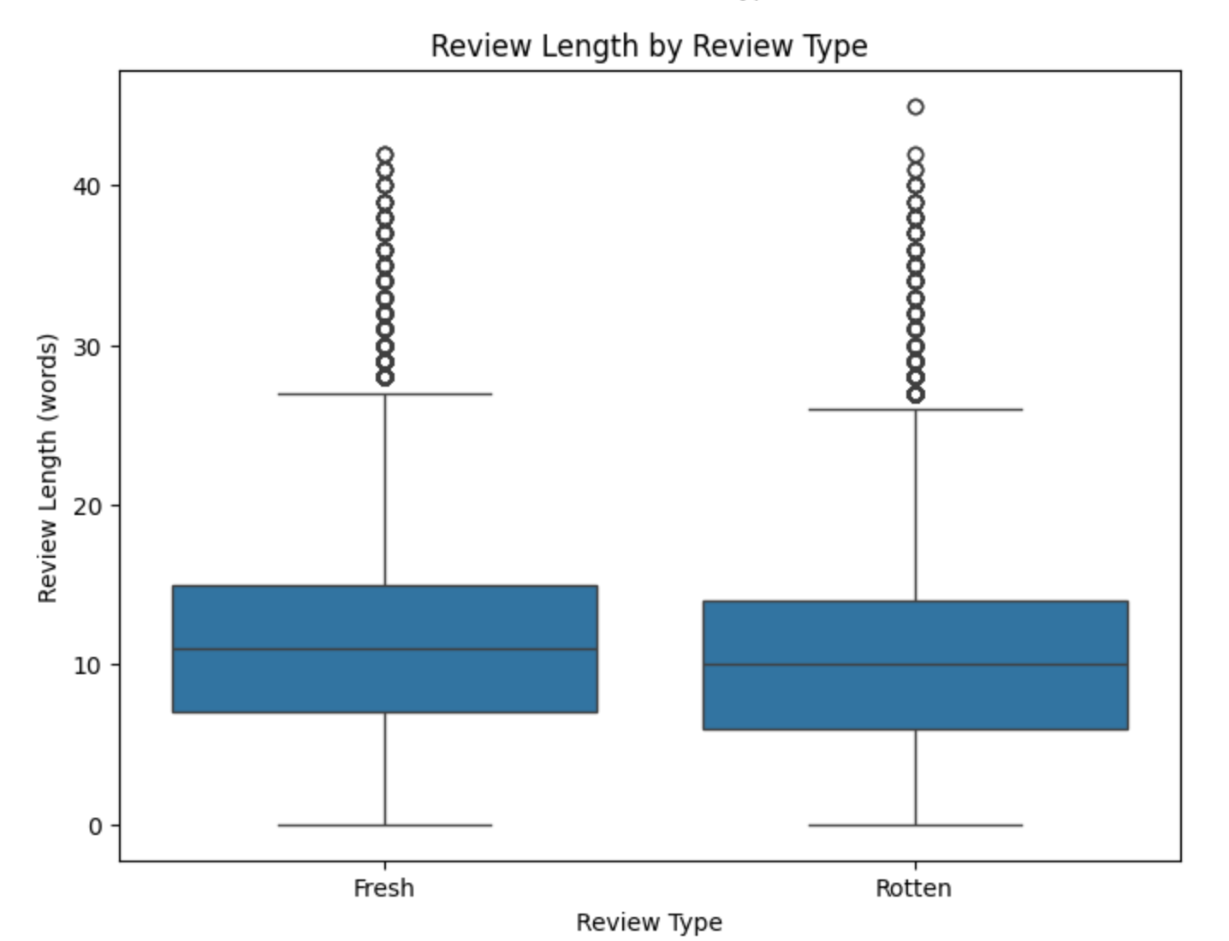
Exploratory Data Analysis
Review Type Distribution
Fresh refers positive, Rotten refers negative, count of positive is more than negative reviews
Median review length for both is 10. But some have significantly long outliers.
Notes:
Slide 12: Exploratory Data Analysis - Review Type Distribution
Script: "Moving on to exploratory data analysis, we first looked at the distribution of review types. Fresh refers to positive reviews, and Rotten refers to negative reviews. We observed that the count of positive reviews is more than negative reviews.
Interpretation:
•Both "Fresh" and "Rotten" reviews have a similar central tendency, with the median review length being around 10 words.
•The variability in review lengths is also similar between the two types, with the majority of reviews falling within a similar range.
•Both review types have a considerable number of outliers, indicating that while most reviews are short, there are some that are significantly longer.

Slide 14
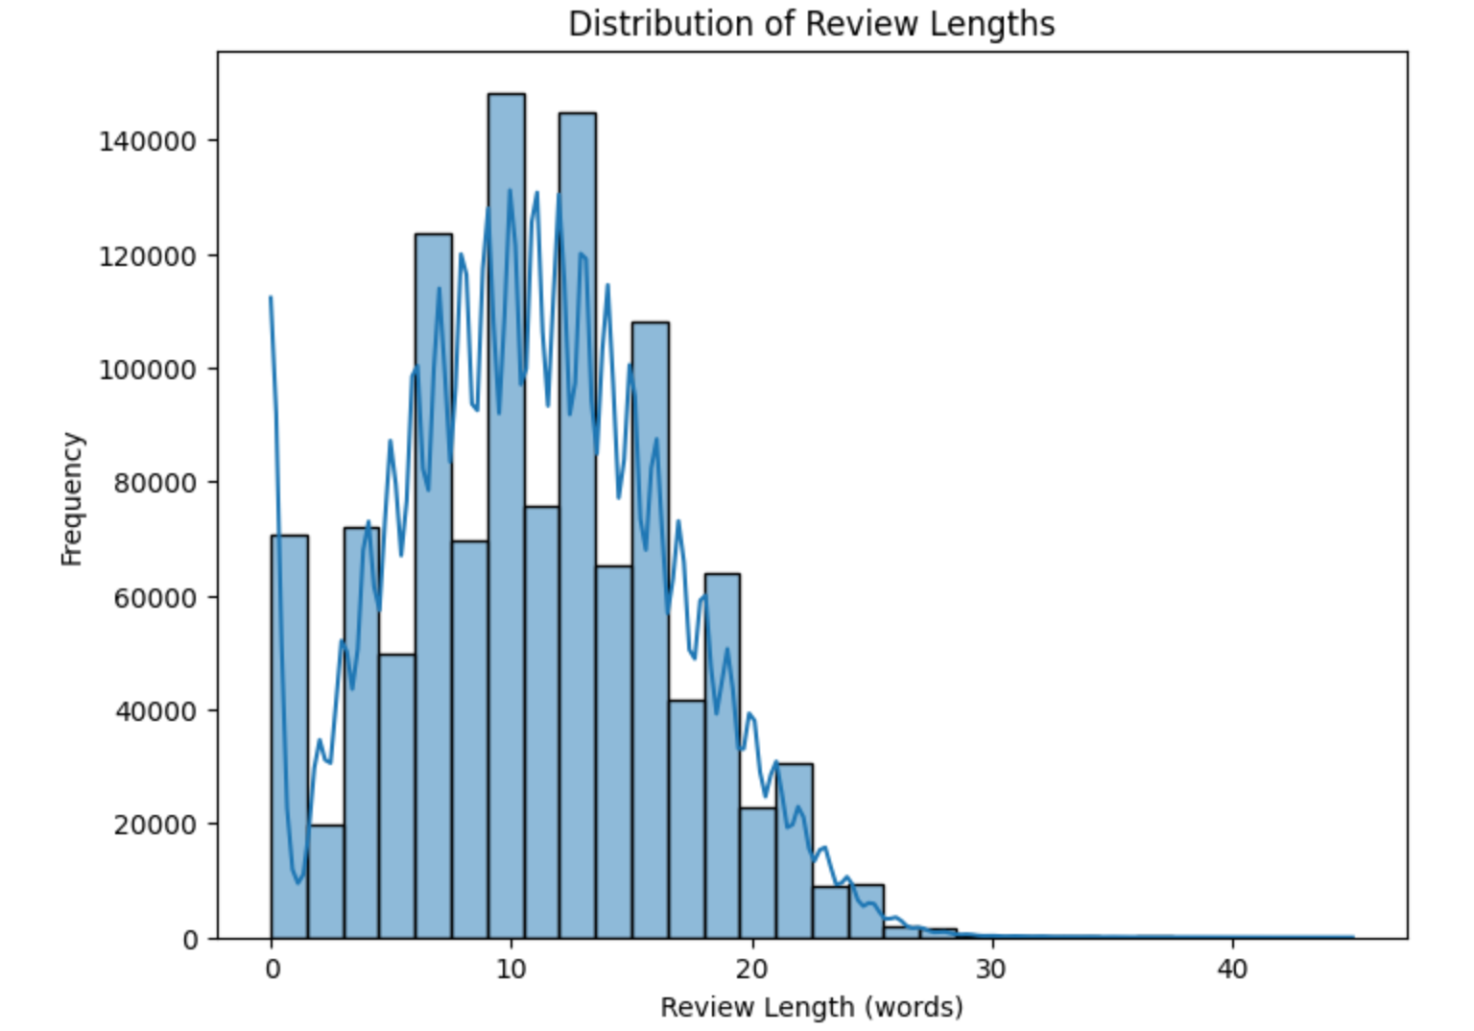
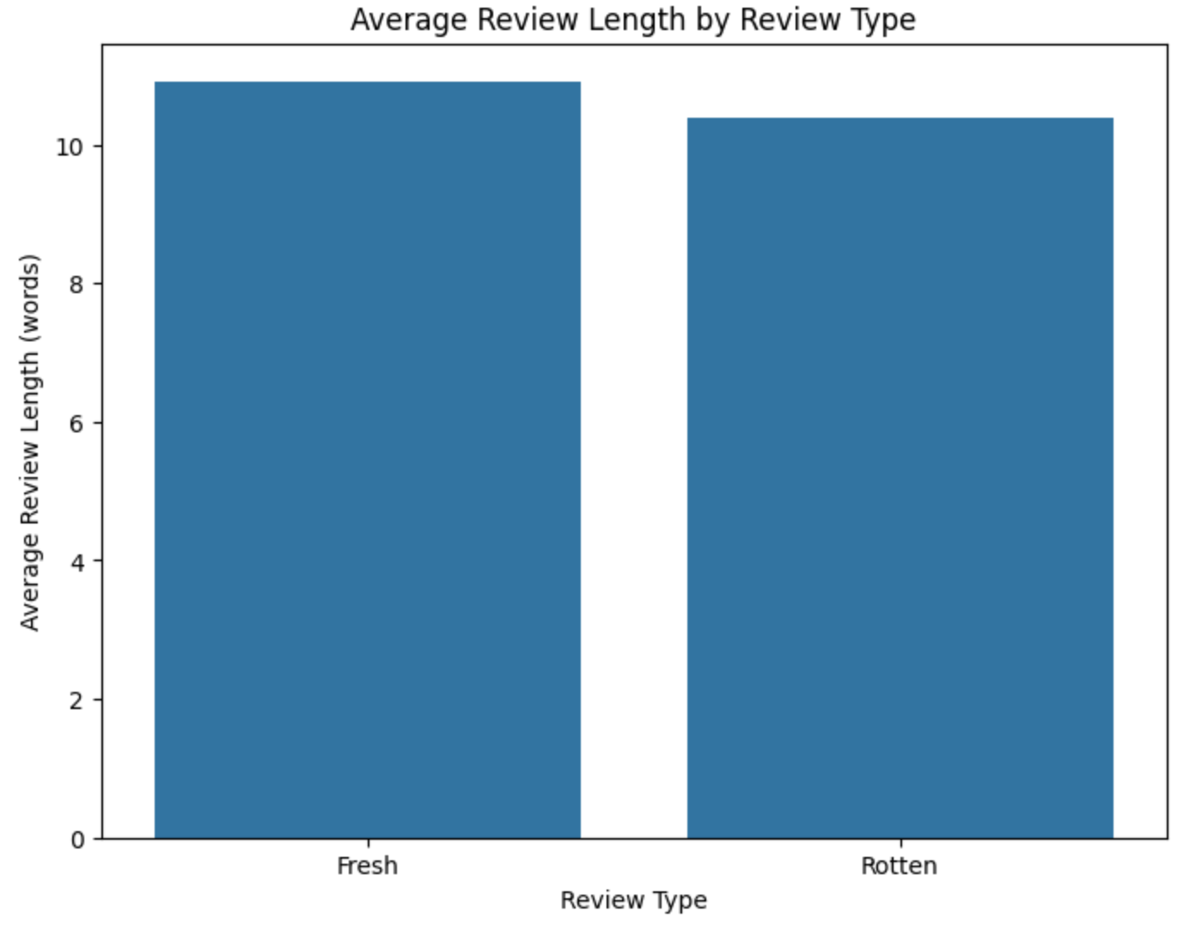
Exploratory Data Analysis Review Length Distribution
Reviews with 10-15 words have highest frequency of approx 140000
Both fresh(positive) & rotten(negative) have average of 10 words in reviews
Notes:
Slide 13: Review Length Distribution
Script: "Next, we analyzed the distribution of review lengths. After Data processing, reviews with 10-15 words have the highest frequency, approximately 140,000. Both fresh and rotten reviews have an average length of about 10 words. This insight helps us understand that reviewers typically provide brief feedback, and the length of the review is not

Slide 15
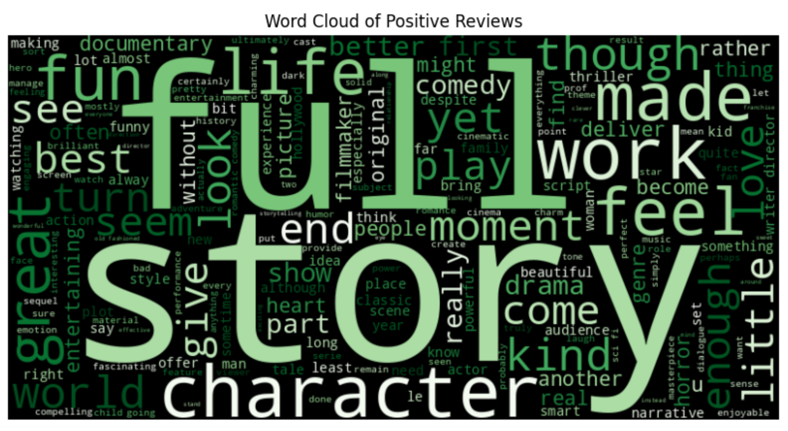
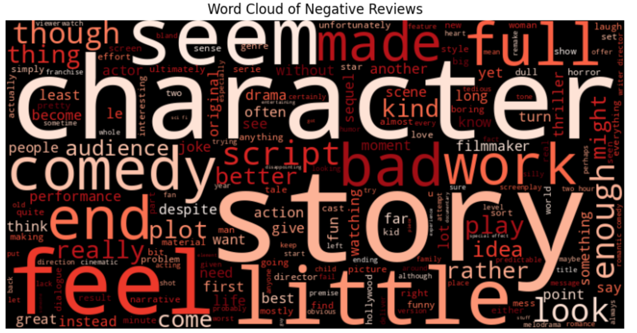
Exploratory Data Analysis Word Cloud Analysis
Word cloud of Positive Reviews: Most used words are full story, end, character, comedy, life, documentary etc.
Word cloud of Negative Reviews: Most used words are character, end, work, story, comedy, plot etc.
Notes:
Slide 14: Word Cloud Analysis
Script: "To visualize the most common words used in reviews, we created word clouds. For positive reviews, commonly used words include 'full', 'story', 'end', 'character', 'comedy', 'life', and 'documentary'. This suggests that positive reviews often focus on the overall story, characters, and genre elements like comedy and life stories.
For negative reviews, common words include 'character', 'end', story,'work', 'comedy', and 'plot'. This indicates that negative reviews also focus on characters and plot but often in a critical manner. These word clouds provide a quick visual summary of the frequently used words in positive and negative reviews."

Slide 16
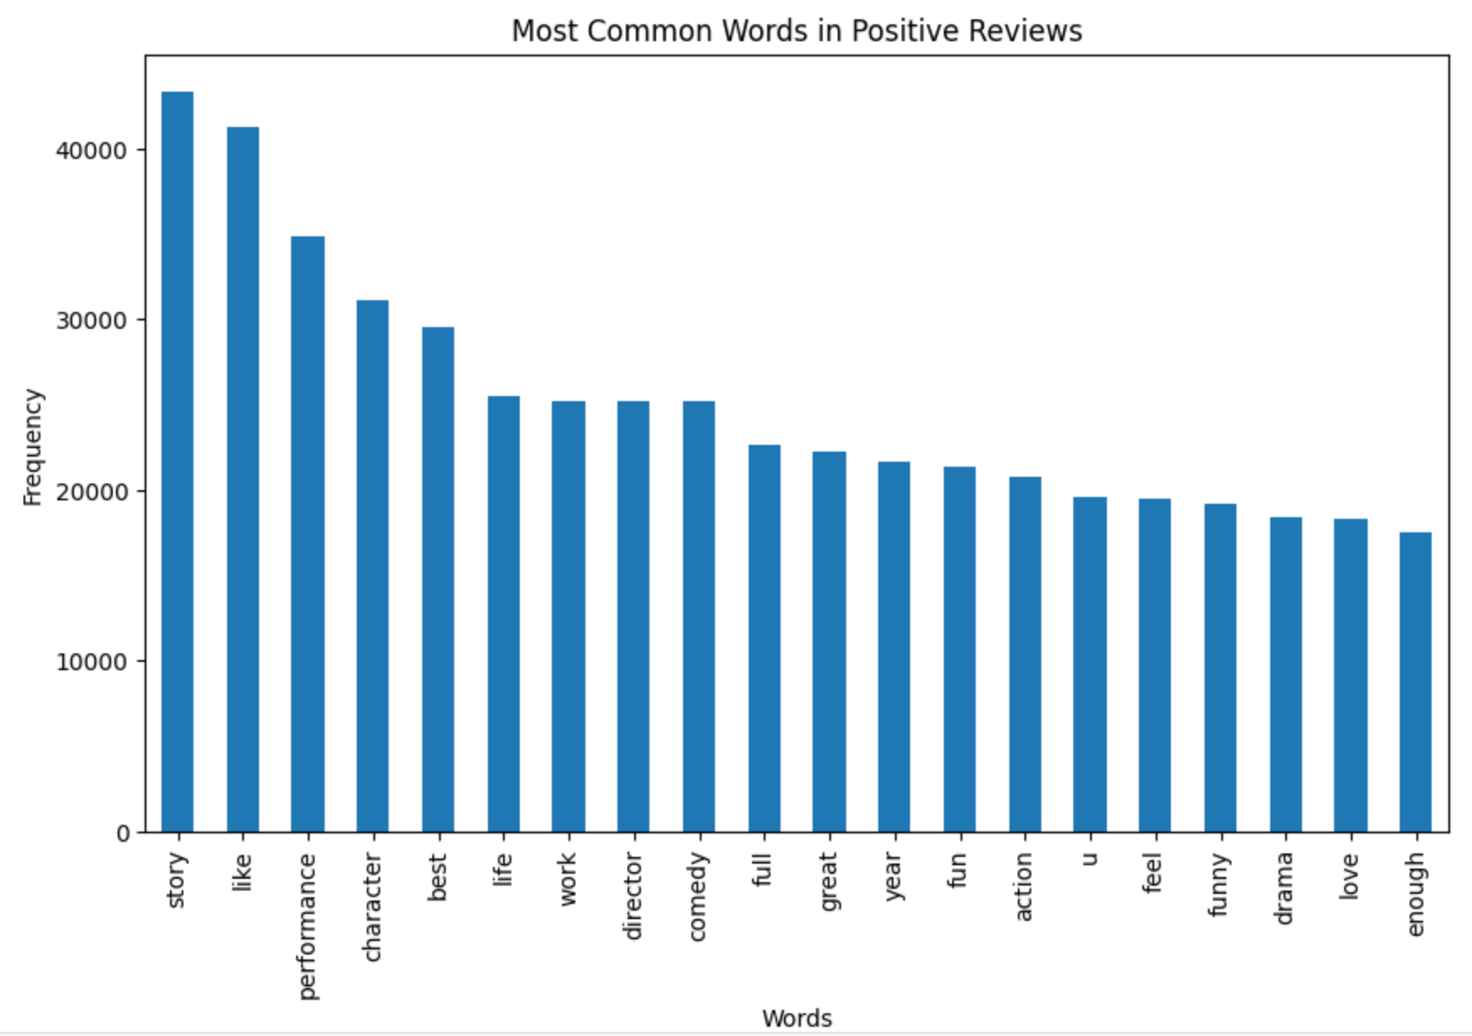
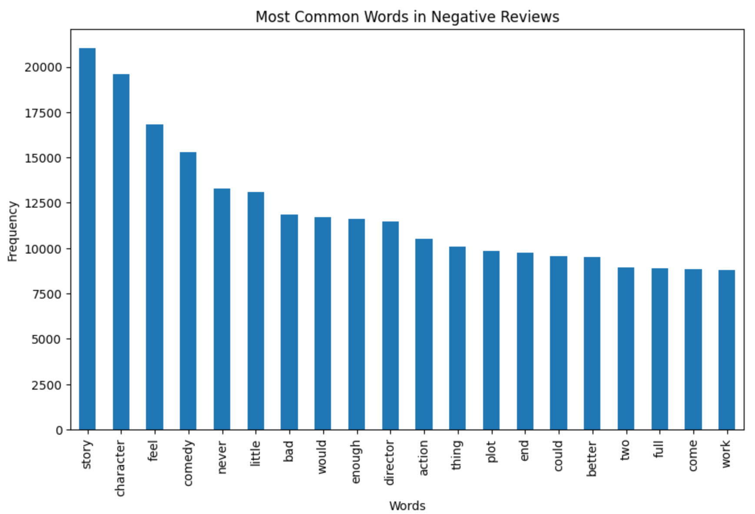
Exploratory Data Analysis Most Common Words
Most Common words in Positive Reviews: Story, like, performance, character, best, life
Most Common words in Negative Reviews: Story, character, feel, comedy, never, little
Notes:
Slide 15: Most Common Words
Script: "We also identified the most common words in positive and negative reviews. In positive reviews, frequent words are 'story', 'like', 'performance', 'character', 'best', and 'life'. This shows that positive reviews often highlight the story, performance, and characters positively. In negative reviews, common words are 'story', 'character', 'feel', 'comedy', 'never', and 'little'. Negative reviews tend to criticize the story and characters, often mentioning how they 'feel' about the film in a negative light. This analysis helps us understand the vocabulary typically associated with different sentiments."

Slide 17
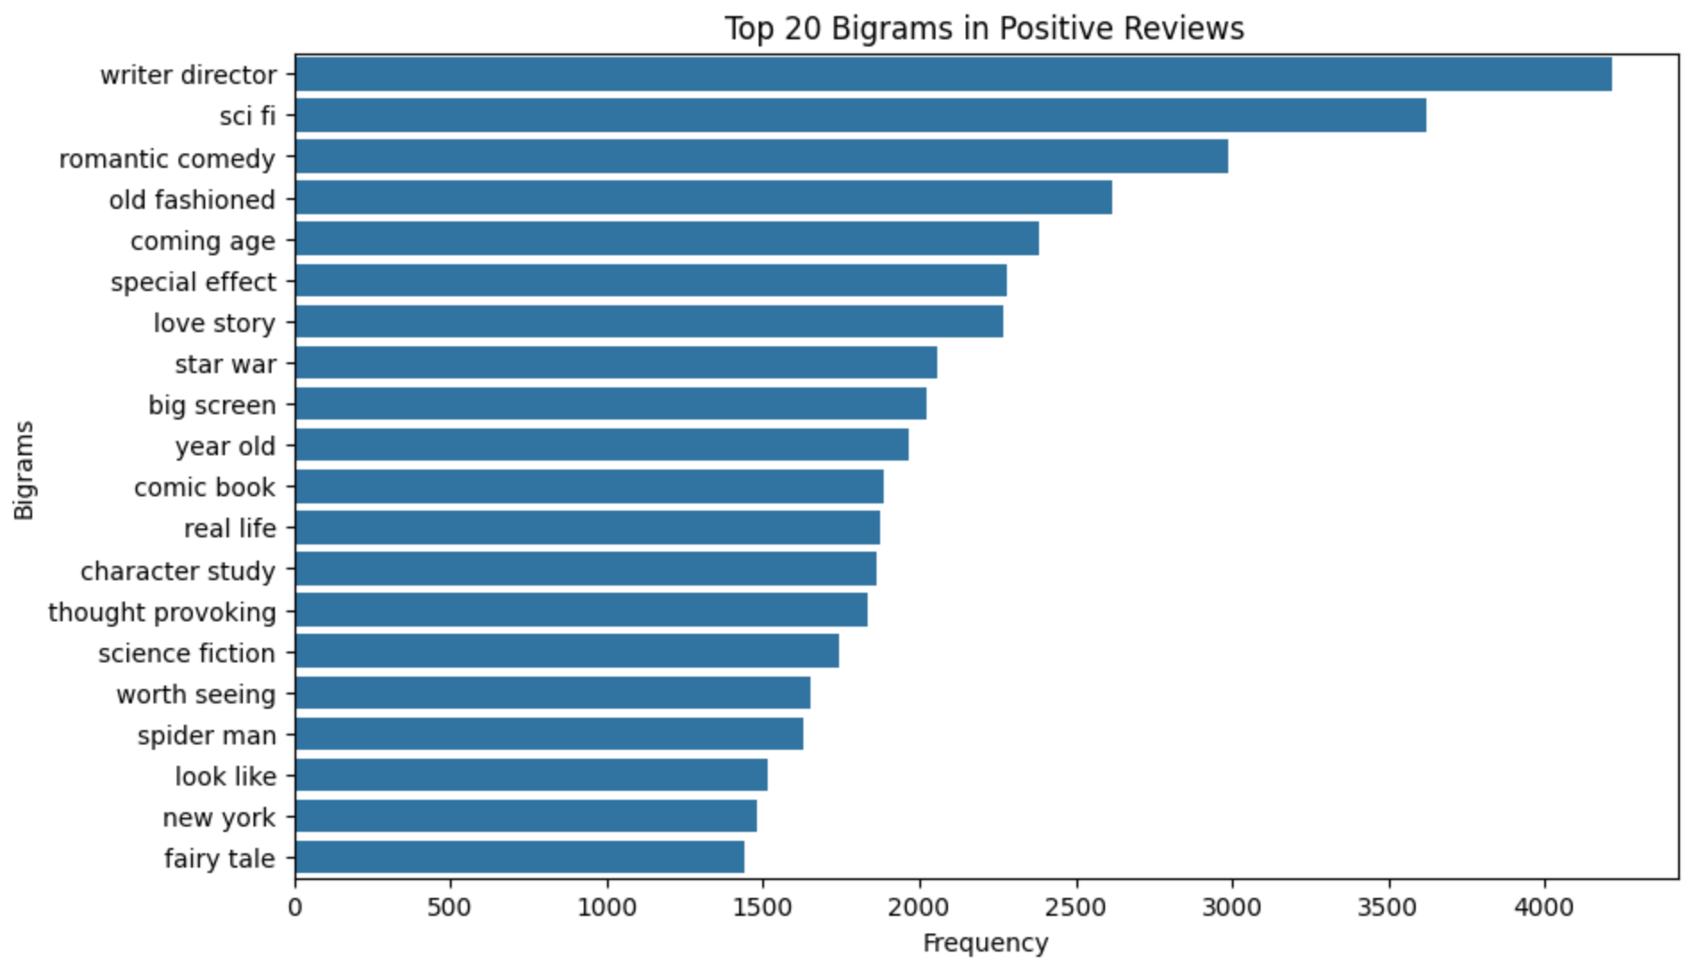
Exploratory Data Analysis Top Bigrams - Positive
Top 20 Positive Bigrams
Writer director with frequency of 4000
Followed by sci fi with frequency of approx 3700
Romantic comedy has frequency of 3000
20th is fairy tale with 1500 frequency
Notes:
Slide 16: Top Bigrams - Positive
Script: "Finally, we looked at the top bigrams in positive and negative reviews. For positive reviews, the top bigrams include 'writer director', 'sci fi', and 'romantic comedy', with frequencies ranging from 1,500 to 4,000. This shows that positive reviews often appreciate the creative direction and genre-specific elements.

Slide 18
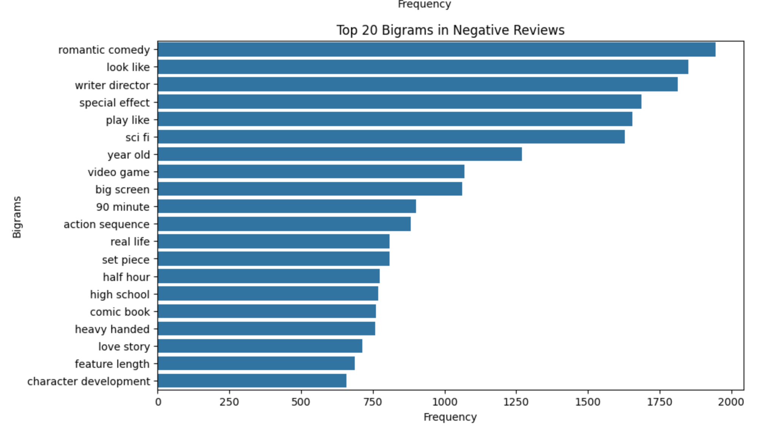
Exploratory Data Analysis​
TOP BIGRAMs - Negative
Top 20 Negative Bigrams
Romantic comedy with frequency of approx. 1900
Followed by look like and writer director
Special effect has frequency of 1750
20th is character development with frequency of approx. 700
Notes:
Slide 17: Top Bigrams - Negative
In negative reviews, common bigrams are 'romantic comedy', 'look like', 'writer director', and 'special effect', with frequencies ranging from 700 to 1,900. This indicates that negative reviews often criticize specific aspects like special effects and genre conventions. Understanding these patterns in bigrams helps us gain deeper insights into what aspects of movies are commonly praised or criticized."
Conclusion
"In conclusion, our exploratory data analysis revealed several meaningful insights:
Positive reviews often highlight the story, performance, and characters positively, while negative reviews focus on criticizing these same aspects.
The length of reviews is generally consistent, with an average of around 10 words, regardless of sentiment.
Word clouds and bigrams helped us identify common themes and focus areas in both positive and negative reviews.
These insights are valuable for understanding audience reception and can potentially help in predicting movie success and guiding marketing strategies."

Slide 19
Model Selection
1
2
3
Logistic Regression
Naive Bayes
Support Vector Machine

Slide 20
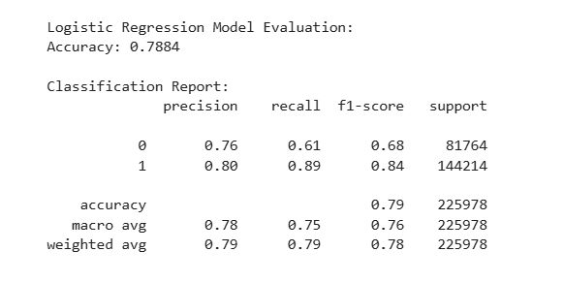
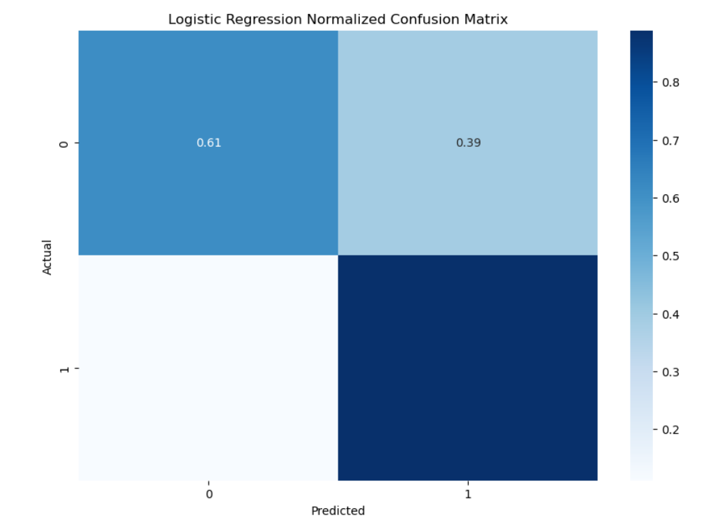
logistic Regression

Slide 21
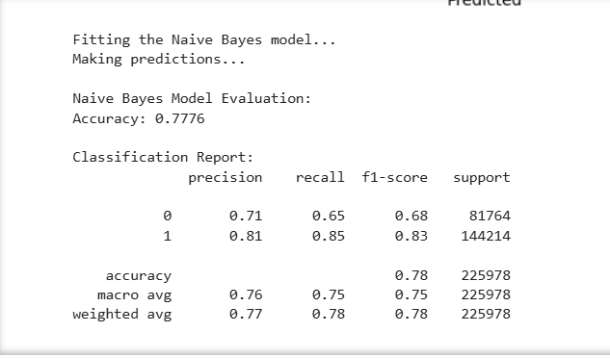
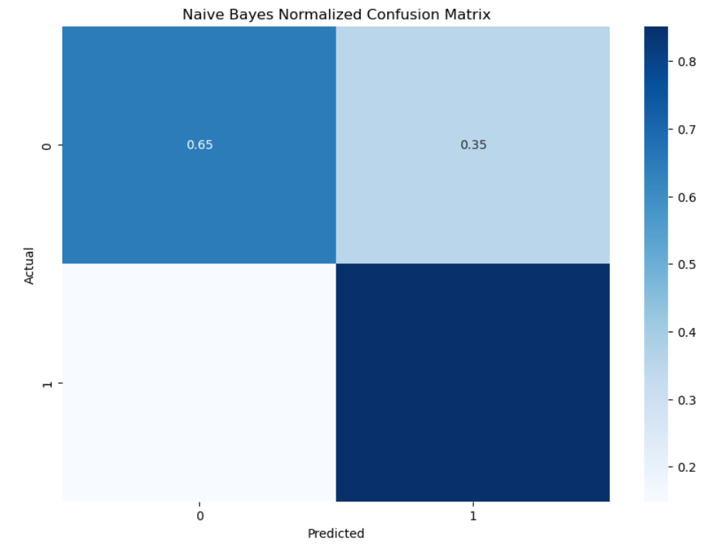
naïve bAYES

Slide 22
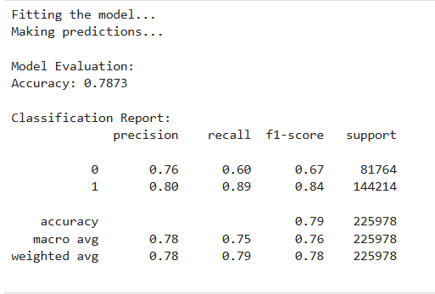
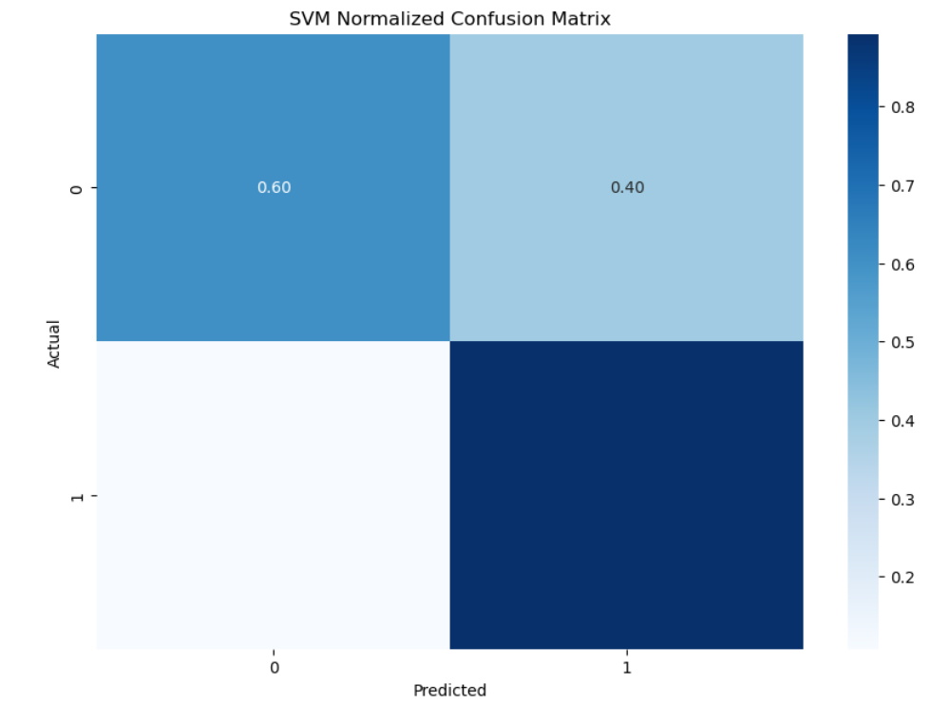
SUPPORT VECTOR MACHINE

Slide 23
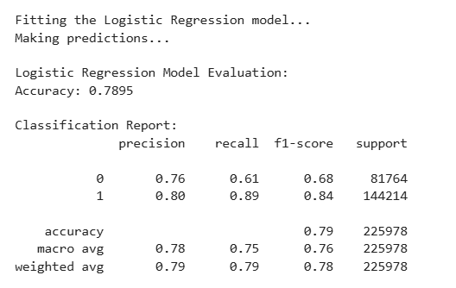
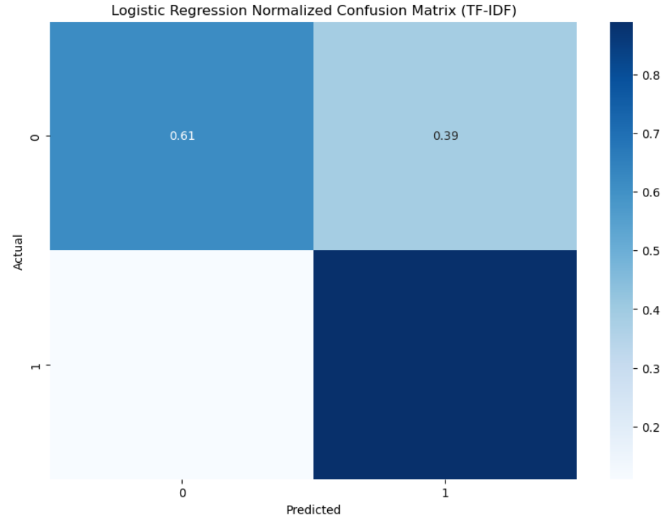
Logistic Regression

Slide 24
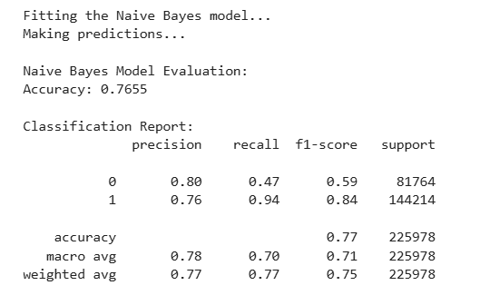
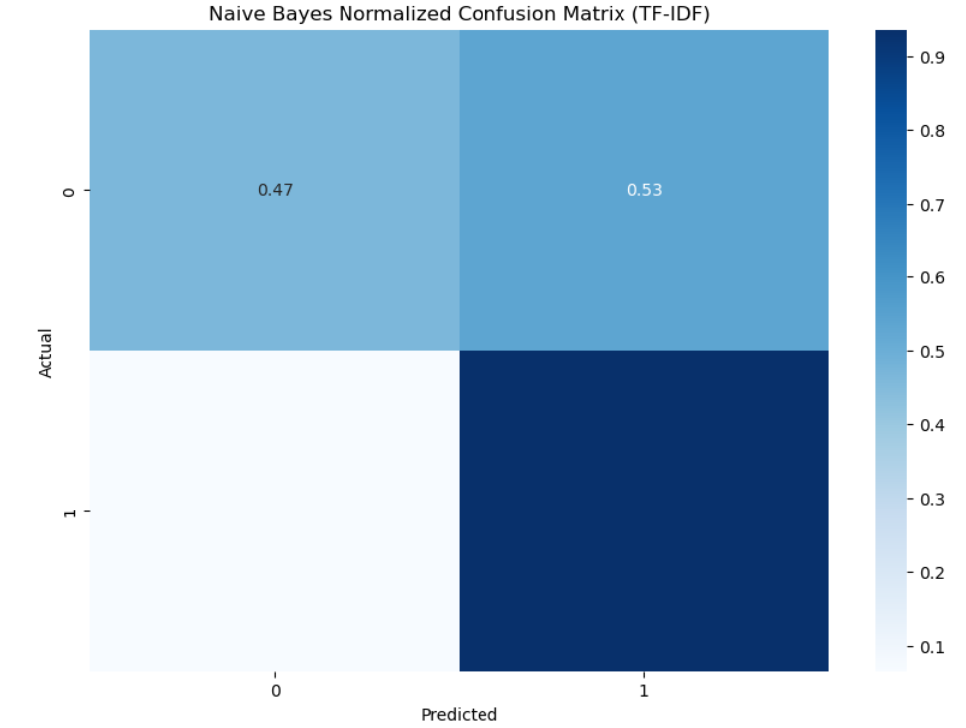
naïve bAYES

Slide 25
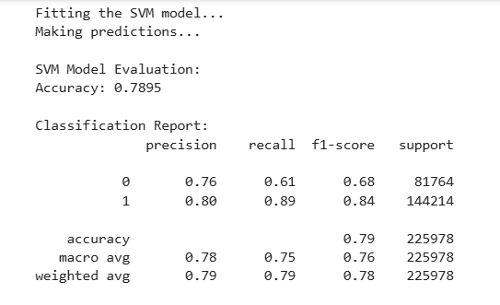

SUPPORT VECTOR MACHINE

Slide 26
Model Performance
 | Accuracy
Bag of Words + Logistic Regression | 0.7884
Bag of Words + Naive Bayes | 0.7776
Bag of Words + SVM | 0.7873
TF-IDF + Logistic Regression | 0.7895
TF-IDF + Naive Bayes | 0.7655
TF-IDF + SVM | 0.7895

Slide 27
Feature Importance

Slide 28
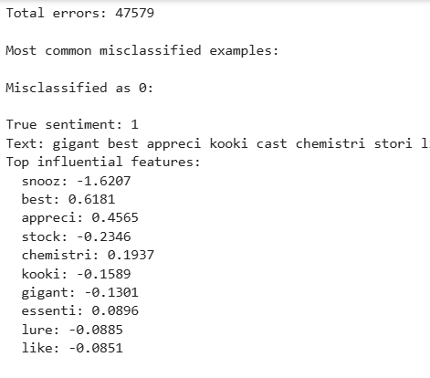
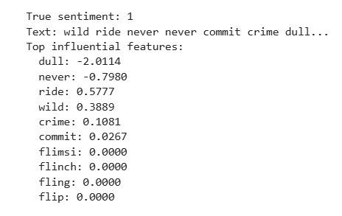
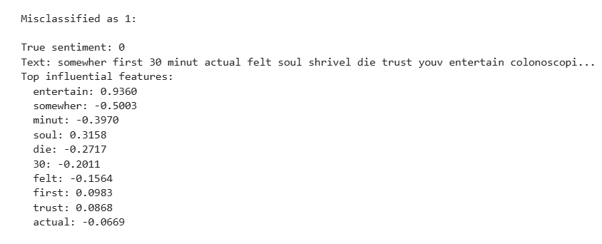
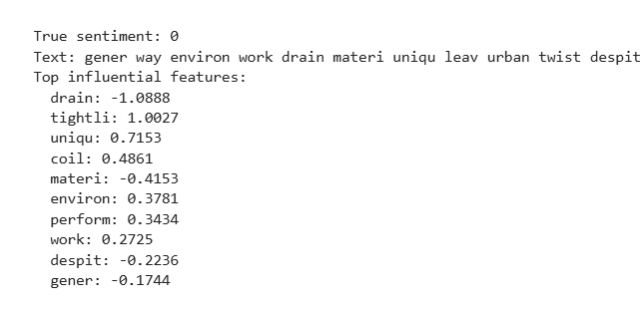
Error Analysis

Slide 29
Error Analysis
Key Insights:
Class imbalance present (favoring positive sentiment)
Models struggle with negations and context
Negative words have stronger influence on classification
Top Sentiment Indicators:
Negative: "unfunny", "fail", "unfortunate", "bland"
Positive: "refresh", "unique", "beautiful"

Slide 30
Challenges & Limitations
Challenges:
Models may misinterpret sarcasm and ambiguity, leading to incorrect sentiment classification.
Feature engineering can be very time-consuming due to large datasets
Aggressive preprocessing can lead to loss of information and reduced model performance.
Strengths: Model effectively identifies strong sentiment indicators (e.g., "unfunny", "refresh"). Capable of recognizing nuanced words like "tightly" and "unique" as positive, demonstrating some contextual understanding.
Weaknesses: Potential class imbalance indicated by model's higher sensitivity to negative words. Top 20 features predominantly negative, suggesting overrepresentation of negative sentiment in training data.

Slide 31



Conclusions
Accuracy Achievement
Sentiment Drivers
EDA
Highest accuracy achieved with TF-IDF + Logistic Regression and TF-IDF + SVM at 78.95%.
Bag of Words + Logistic Regression also performed well with an accuracy of 78.84%.
Fresh (positive) reviews slightly outnumbered Rotten (negative) review
Common words in positive reviews: “story”, “performance”, “character”
Common words in negative reviews: “feel”, “never”, “little”
Top positive bigrams: "writer director," "sci fi," "romantic comedy.“
Top negative bigrams: "romantic comedy," "look like," "special effect.“
Fresh and Rotten reviews both averaged around 10 words, with outliers extending beyond 40 words.

Slide 32
Team Members: Diksha Raina – Model Analysis (Logistic Regression, Naïve Bayes, SVM), Error Analysis Sama Bhavsar – Data Cleaning & processing, challenges, conclusions Dipali Khatri – exploratory Data Analysis, Feature Engineering
Thank
thank
Thank
You
You
You
Thank you

